Slide 1
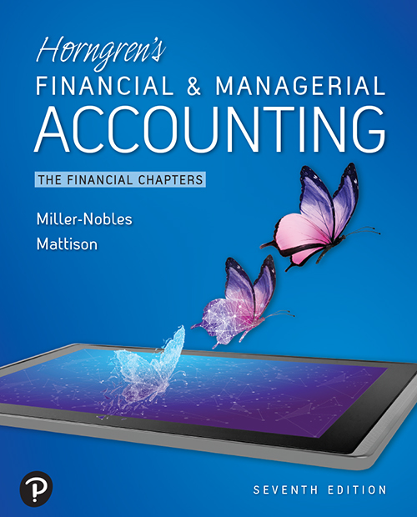

Horngren’s Financial & Managerial Accounting
Seventh Edition
Chapter 1
Accounting in the Business Environment
Copyright © 2021 Pearson Education, Inc. All Rights Reserved
Notes:
If this PowerPoint presentation contains mathematical equations, you may need to check that your computer has the following installed:
1) MathType Plugin
2) Math Player (free versions available)
3) NVDA Reader (free versions available)
Slides in this presentation contain hyperlinks. JAWS users should be able to get a list of links by using INSERT+F7

Slide 2

Chapter 1 Learning Objectives (1 of 2)
1.1 Explain why accounting is important and list the users of accounting information
1.2 Describe the organizations and rules that govern accounting
1.3 Describe the accounting equation and define assets, liabilities, and equity

Slide 3
Chapter 1 Learning Objectives (2 of 2)
1.4 Use the accounting equation to analyze transactions
1.5 Prepare financial statements
1.6 Use financial statements and return on assets (R O A) to evaluate business performance

Slide 4

Learning Objective 1.1
Explain why accounting is important and list the users of accounting information

Slide 5
Why Is Accounting Important?
Accounting is the information system that:
Measures business activities
Processes the information into reports
Communicates the results to decision makers
Notes:
Accounting is the information system that measures business activities, processes the information into reports, and communicates the results to decision makers. Accounting is the language of business. The better you understand the language of business, the better you can manage your own business, be a valuable employee, or make wise investment decisions.

Slide 6
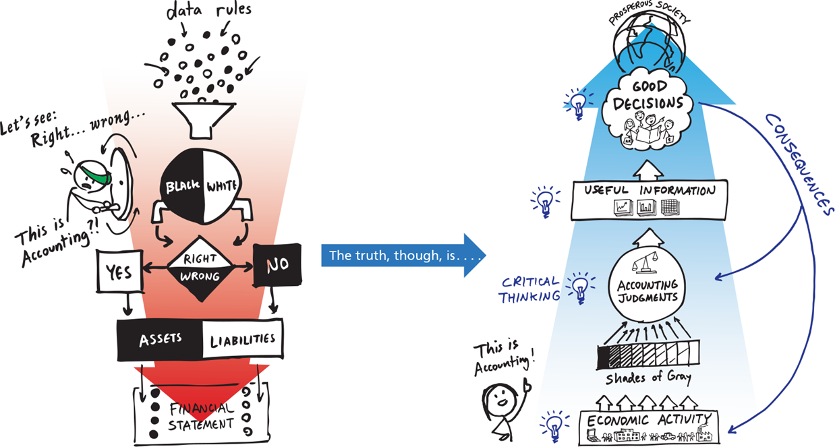
Exhibit F:1-1 Pathways Vision Model
This work is by The Pathways Commission. The Pathways Vision Model: A I artwork: A A A Commons. American Accounting Association.
Notes:
Accountants participate in a broad range of activities, such as the investigation of financial evidence, the development of computer programs to process accounting information, and the communication of financial results to interested parties. Accounting is used every day to help make good business decisions.
The Pathways vision model was created to help students and the public understand what accounting is and how its is used in business decision making. Accounting starts with economic activities that accountants review and evaluate using critical thinking and judgment. Accountants play a critical role in supporting a prosperous society.
Accounting involves critical thinking. Economic activity leads to shades of gray that must be interpreted using accounting judgments. Accounting judgments produce useful information that leads to good decisions. These decisions have consequences for future economic activity and accounting judgments, and they contribute to a prosperous society.

Slide 7
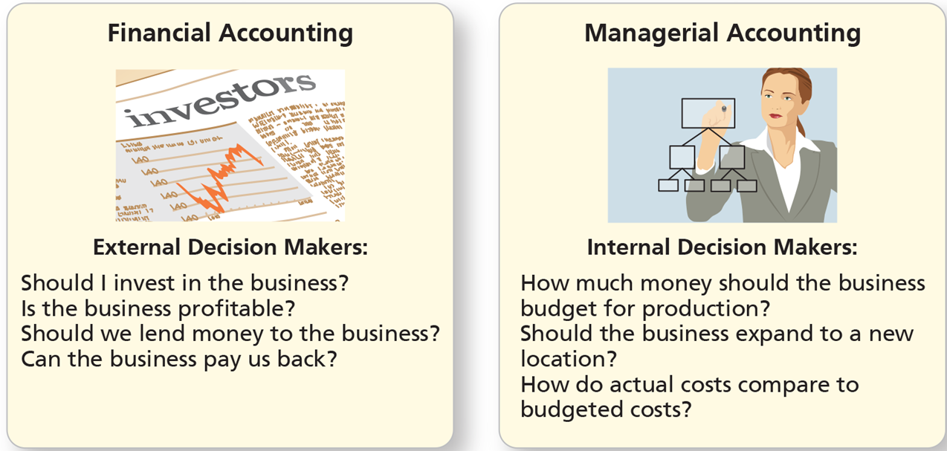
Decision Makers: The Users of Accounting Information (1 of 2)
Exhibit F:1-2 Decision Making: Financial Versus Managerial Accounting
Notes:
Accounting is divided into two fields: financial accounting and managerial accounting. Financial accounting provides information for external decision makers, such as outside investors, lenders, customers, and government entities.
Managerial accounting focuses on information for internal decision makers, such as the company’s managers and employees.
Financial Accounting involves external decision makers: Should I invest in the business? Is the business profitable? Should we lend money to the business? Can the business pay us back?
Managerial accounting involves internal decision makers: How much money should the business budget for production? Should the business expand to a new location? How do actual costs compare to budgeted costs?

Slide 8
Decision Makers: The Users of Accounting Information (2 of 2)
Financial accounting provides information for external decision makers, such as:
Investors who own a portion of the business
Creditors to whom the business owes money
Taxing authorities, to whom the business owes taxes
Managerial accounting provides information to internal decision makers, such as:
Managers
Employees
Individuals
Businesses
Notes:
Individuals use accounting information to make decisions such as how much money to save for college or to purchase a new computer. Business owners use accounting information to set goals, measure progress toward those goals, and make adjustments when needed. Outside investors have an ownership interest in the business and often provide money to get a business started. A creditor is any person or business to whom the business owes money. And taxing authorities collect taxes levied on a business’s income or assets.

Slide 9
Accounting Matters (1 of 2)
Types of accountants:
Certified Public Accountants (C P A s) serve the general public.
Chartered Global Management Accountant (C G M A s) have advanced knowledge in finance, operations, strategy, and management.
Certified Management Accountants (C M A s) specialize in accounting and financial management knowledge and often work for a single company
Notes:
Certified Public Accountants (CPAs) are licensed professional accountants who service the general public. CPAs work for public accounting firms, businesses, government entities, or educational institutions. To become a CPA you must meet educational and/or experience requirements (that vary by state) and pass a qualifying exam. Chartered Global Management Accountant (CGMAs) are professional accountants that have advanced knowledge in finance, operations, strategy, and management. The American Institute of Certified Public Accountants (AICPA) Web site (http://www.thiswaytocpa.com) contains a wealth of information about becoming a CPA or CGMA, career opportunities, and exam requirements.
Certified Management Accountants (CMAs) are certified professionals who specialize in accounting and financial management. Generally, CMAs work for a single company. Visit the Institute of Management Accountants (IMA) Web site for more information: http://www.imanet.org.
Accountants generally work either in public, private, or governmental accounting.

Slide 10
Accounting Matters (2 of 2)
Types of accountants:
Certified Public Accountants (C P A s) serve the general public.
Chartered Global Management Accountants (C G M A s) have advanced knowledge in finance, operations, strategy, and management.
Certified Management Accountants (C M A s) specialize in accounting and financial management knowledge and often work for a single company.
Certified Financial Planners (C F P s) help individuals budget, plan for retirement, save for education, and manage their finances.
Notes:
Certified Public Accountants (CPAs) are licensed professional accountants who service the general public. CPAs work for public accounting firms, businesses, government entities, or educational institutions. To become a CPA you must meet educational and/or experience requirements (that vary by state) and pass a qualifying exam. Chartered Global Management Accountant (CGMAs) are professional accountants that have advanced knowledge in finance, operations, strategy, and management. The American Institute of Certified Public Accountants (AICPA) Web site (http://www.thiswaytocpa.com) contains a wealth of information about becoming a CPA or CGMA, career opportunities, and exam requirements.
Certified Management Accountants (CMAs) are certified professionals who specialize in accounting and financial management. Generally, CMAs work for a single company. Visit the Institute of Management Accountants (IMA) Web site for more information: http://www.imanet.org.
Certified Financial Planners (CFPs) help individuals budget, plan for retirement, save for education, and manage their finances. Individuals who want to obtain their CFP must have the four E’s: education, examination, experience, and ethics. You can find out more about becoming a CFP on the following Web site: https://www.cfp.net/home.
Accountants generally work either in public, private, or governmental accounting.

Slide 11
Exhibit F:1-3 Comparison of Accounting Positions
Position | Job Description | Salary Range
Controllers | Compile financial statements, interact with auditors, and oversee regulatory reporting. | $92,000 – $207,750
Financial analysts | Review financial data and help to explain the story behind the numbers. | $42,500 – $201,250
Business systems analysts | Use accounting knowledge to create computer systems. | $42,500 – $185,000
Tax accountants | Help companies navigate tax laws. | $39,500 – $212,250
Auditors | Perform reviews of companies to ensure compliance to rules and regulations. | $39,500 – $208,750
Cost accountants | Typically work in a manufacturing business. Help analyze accounting data. | $42,000 – $143,750
Accounting clerks/ Bookkeepers | Record financial transactions and help prepare financial records. | $28,250 – $65,750
Based on Robert Half’s 2019 Salary Guide
https://www.roberthalf.com/salary-guide
Notes:
Studying accounting and becoming certified professionally can lead to a financially secure job. Tax accountants, auditors, and accounting clerks/bookkeepers tend to service multiple clients and work in public accounting. Controllers, financial analysts, and cost accountants tend to work for a single company and work in private accounting. Other accountants work for federal or state governments. Demand for accountants is high, and employment is expected to 10% (grow faster than average) from 2016-2026.

Slide 12
Data Analytics in Accounting
Accountants need to understand how technology is used to process financial information
Accounting and finance individuals actively work with information technology teams to develop accounting systems.
Artificial intelligence, cloud-based systems, and robotic process automation are all changing the way companies handle financial information.
Notes:
Today’s accountants need to know more than just accounting knowledge. They also need to understand how technology is used to process financial information. Accounting and finance individuals actively work with information technology teams to develop accounting systems. Artificial intelligence, cloud-based systems, and robotic process automation are all changing the way companies handle financial information. Ideal accounting employees have knowledge in both accounting and technology.

Slide 13
Learning Objective 1.2
Describe the organizations and rules that govern accounting

Slide 14
What Are the Organizations and Rules That Govern Accounting? (1 of 3)
Governing organizations:
The Financial Accounting Standards Board (F A S B) oversees creation and governance of accounting standards.
The Securities and Exchange Commission (S E C) oversees the U.S. financial markets.
Notes:
In the United States, the Financial Accounting Standards Board (FASB), a privately funded organization, oversees the creation and governance of accounting standards. The FASB works with governmental regulatory agencies like the Securities and Exchange Commission (SEC). The SEC is the U.S. governmental agency that oversees the U.S. financial markets.

Slide 15
What Are the Organizations and Rules That Govern Accounting? (2 of 3)
Accounting guidelines are called Generally Accepted Accounting Principles (G A A P).
Useful accounting information must:
Be relevant, allowing users to make a decision
Have faithful representation by being complete, neutral, and free from error
Notes:
Generally Accepted Accounting Principles (GAAP) are the guidelines for accounting information. GAAP is governed by the FASB, and GAAP rules are used to prepare financial statements. The primary objective of financial reporting is to provide useful information. In order for information to be useful, it must be relevant and have faithful representation. Relevant information allows the user to make informed decisions. Information is faithfully represented when it is complete, neutral, and free from error.

Slide 16
The Economic Entity Assumption (1 of 5)
An organization that stands apart as a separate economic unit follows the economic entity assumption.
An Economic Entity can be a:
Sole Proprietorship
Partnership
Corporation
Limited-Liability Company (L L C)
Notes:
An economic entity is an organization that stands apart as a separate economic unit. An entity is a separate economic unit when it is separate from its owners. There are various types of business entities, including sole proprietorships, partnerships, corporations, and limited liability companies (LLCs).

Slide 17
The Economic Entity Assumption (2 of 5)
Exhibit F:1-4 Business Organizations
Blank | Sole Proprietorship | Partnership | Corporation | Limited-Liability Company (L L C)
Definition | A business with a single owner | A business with two or more owners and not organized as a corporation | A business organized under state law that is a separate legal entity | A company in which each member is only liable for his or her own actions
Number of owners | One (called the proprietor) | Two or more (called partners) | One or more (called stockholders) | One or more (called members or partners)
Life of the organization | Terminates at owner’s choice or death | Terminates at a partner’s choice or death | Indefinite | Indefinite
Personal liability of the owner(s) for the business’s debts | The owner is personally liable. | The partners are personally liable. | Stockholders are not personally Liable. | Members are not personally Liable.
Notes:
A sole proprietorship is a business with a single owner.
A partnership is a business with two or more owners and not organized as a corporation.
A corporation is a business organized under state law that is a separate legal entity.
A limited-liability company (LLC) is a company in which each member is liable only for his or her own actions.

Slide 18
The Economic Entity Assumption (3 of 5)
[Exhibit F:1-4 Continued]
Blank | Sole Proprietorship | Partnership | Corporation | Limited-Liability Company (L L C)
Taxation | Not separate taxable entities. The owner pays tax on the proprietorship’s earnings. | Partnership is not taxed. Instead partners pay tax on their share of the earnings. | Separate taxable entity. Corporation pays tax. | L L C is not taxed. Instead members pay tax on their share of earnings.
Type of business | Small businesses | Professional organizations of physicians, attorneys, and accountants | From small business to large multinational businesses | An alternative to the partnership

Slide 19
The Economic Entity Assumption (4 of 5)
Features of a corporation:
Separate legal entity
Continuous life and transferability of ownership
No mutual agency
Limited liability of stockholders (owners of the corporation)
Separation of ownership and management
Corporate taxation
Government regulation
Notes:
A corporation is a type of business entity that is separate from its owners in a variety of ways:
Legal corporate formation with the appropriate state
Continuous life and ease in transferability of ownership
No mutual agency, so stockholders cannot commit the corporation to a contract unless the stockholder is acting in a management role on behalf of the business
Stockholders have limited liability for the debts of the corporation
Separate taxation

Slide 20
The Economic Entity Assumption (5 of 5)
Organization of a corporation:
Creation begins when organizers (called incorporators) obtain a charter from the state.
The charter includes authorization for a certain number of shares of stock, which represent ownership in the corporation.
Incorporators also agree on the bylaws that guide the organization.
Once created, stockholders control the corporation through an elected board of directors.
Notes:
The creation of a corporation begins when its organizers, called the incorporators, obtain a charter from the state. The charter includes the authorization for the corporation to issue a certain number of shares of stock, which represent the ownership in the corporation. The incorporators pay fees, sign the charter, and file the required documents with the state. Once the first share of stock is issued, the corporation comes into existence. The incorporators agree to a set of bylaws, which act as the constitution for governing the corporation. Bylaws are the rule book that guides the corporation. The ultimate control of the corporation rests with the stockholders, which elect a board of directors.

Slide 21
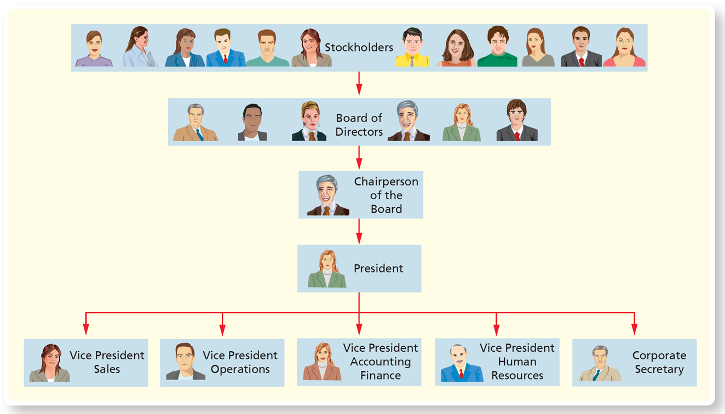
Exhibit F:1-5 Structure of a Corporation
Notes:
Stockholders own stock in a corporation and are, therefore, owners of the corporation. Stockholders normally receive one vote for each share of stock they own, and they control the corporation with their votes. Stockholders elect the board of directors, which sets policy for the corporation and appoints the officers. The board of directors elects a chairperson and designates the president of the corporation. Corporations have employees in various positions.
In the hierarchal chart, each item represents people at a certain level in the corporate structure. The people in each item are responsible for overseeing those listed after them. Stockholders, Board of directors, Chairman of the board, President, Vice presidents of sales, operations, accounting and finance, and human resources, and the corporate secretary

Slide 22
What Are the Organizations and Rules That Govern Accounting? (3 of 3)
In addition to the economic entity principle, the following principles are part of G A A P:
The cost principle states that acquired assets and services should be recorded at their actual cost.
The going concern assumption assumes that the entity will remain in operation for the foreseeable future.
The monetary unit assumption requires that the items on the financial statements be measured in terms of a monetary unit.
Notes:
GAAP provides the rules that govern accounting, which include the economic entity assumption, the cost principle, the going concern assumption, and the monetary unit assumption.
The cost principle states that assets should be recorded at their actual cost on the date of acquisition. Assets will continue to be reported at their historical cost over their useful life.
The going concern assumption assumes that an entity will remain in operation for the foreseeable future.
The monetary unit assumption requires that items on financial statements be measured in terms of a monetary unit. In the United States, we use dollars because the dollar is the medium of exchange. Accountants assume that the dollar’s purchasing power is stable. Inflation occurs when prices rise and the purchasing power of a dollar decreases.

Slide 23
International Financial Reporting Standards
International Financial Reporting Standards (I F R S) are a set of global accounting guidelines.
Used or required by more than 166 nations/jurisdictions
Published by the International Accounting Standards Board (I A S B)
Notes:
The SEC requires that U.S. businesses follow U.S. GAAP. Companies that are incorporated in other countries or that do significant business in other countries may be required to use International Financial Reporting Standards (IFRS), which are published by the International Accounting Standards Board (IASB). More than 166 nations/jurisdictions use IFRS standards. IFRS standards are typically less specific (contain fewer rules) than U.S. GAAP.

Slide 24
Ethics in Accounting and Business
An audit is an examination of a company’s financial statements and records.
The Sarbanes-Oxley Act (S O X) requires companies to review internal controls.
The Public Company Accounting Oversight Board (P C A O B) monitors the work of independent accountants who audit public companies.
Notes:
To handle conflicts of interest and to provide reliable information, the SEC requires publicly held companies to have their financial statements audited by independent accountants. An audit is an examination of a company’s financial records and statements. In it, an independent auditor issues an opinion on the state of the company’s financial situation.
In response to various accounting scandals, the U.S. government passed the Sarbanes-Oxley Act (SOX), which is intended to curb financial scandals. According to SOX, it is a criminal offense to falsify financial statements. SOX also created the Public Company Accounting Oversight Board (PCAOB) to monitor the work of independent accountants who audit public companies.

Slide 25

Learning Objective 1.3
Describe the accounting equation and define assets, liabilities, and equity

Slide 26
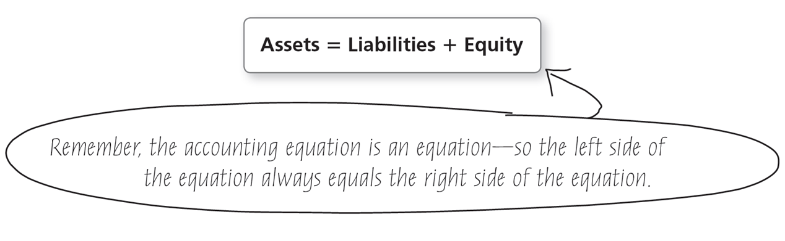
What Is the Accounting Equation?
The accounting equation is the basic tool of accounting, measuring the resources of the business and the claims to those resources.
Notes:
The accounting equation measures the resources of a business (what the business owns or has control of) and the claims to those resources (what the business owes to creditors and to the owners). The accounting equation includes assets, liabilities, and equity. Assets appear on the left side of the accounting equation, and liabilities and equity appear on the right.
Assets = Liabilities + Equity

Slide 27
Assets
An asset is an economic resource that is expected to benefit the business in the future.
Examples:
Cash
Merchandise Inventory
Furniture
Land
Notes:
Assets are something of value a business owns or has control of, such as Cash, Merchandise Inventory, Furniture, or Land.

Slide 28
Liabilities
Liabilities are debts that are owed to creditors.
Many liabilities have the word payable in their titles.
Examples:
Accounts Payable
Notes Payable
Salaries Payable
Notes:
Claims to assets come from either liabilities or equity. Liabilities are amounts the business owes; they represent the creditors’ claims on the business’s assets.

Slide 29
Equity (1 of 3)
The owners’ claims to the assets of the business are called equity (also called stockholders’ equity), which has two components:
Contributed capital:
Also called paid-in capital, contributed capital is the amount invested in the corporation by its owners, the stockholders.
Common stock represents the basic ownership of every corporation.
Retained earnings:
Equity earned from profitable operations that is not distributed to shareholders
Notes:
Equity represents the amount of assets that are left over after the company has paid its liabilities, which is the company’s net worth.
The amount of cash or property invested by owners in the business is called contributed capital. Contributed capital is also called paid-in capital, and ownership is evidenced by common stock.
Retained earnings is the equity earned by profitable operations that is not distributed to stockholders. Dividends and expenses decrease retained earnings, while revenues increase retained earnings.

Slide 30
Equity (2 of 3)
Increases in equity result from:
Contributed capital (owner contributions)
Revenues, which are amounts earned from delivering goods or services o customers
Decreases in equity result from:
Dividends, which are distributions of earnings to stockholders
Expenses or the costs of selling goods or services
Notes:
Equity increases with owner contributions and revenues. Owner contributions of cash or property are referred to as contributed capital. Revenues are earnings that result from delivering goods or providing services to customers.
Equity decreases with distributions to owners and expenses. Expenses are the cost of selling goods or services. Distributions of cash or property to stockholders are called dividends.

Slide 31
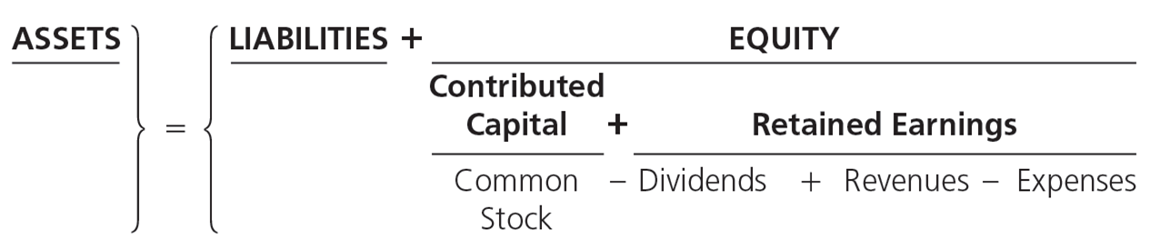
Equity (3 of 3)
The accounting equation is expanded to show the components of equity:
Net income
Revenues > Expenses
Net loss
Revenues < Expenses
Notes:
The accounting equation is expanded to show the changes in equity due to contributed capital, dividend payments, revenues, and expenses.
When revenues exceed expenses, the result is called net income. On the other hand, when expenses exceed revenues, a net loss results. Businesses strive for net income.
A corporation can determine the change in equity from the beginning of the year to the end of the year by using the expanded components of equity. Issuances of common stock and revenues earned during the year will always increase equity, and dividends distributed and expenses incurred during the year always decrease equity. Therefore, a corporation’s ending equity is calculated as follows:
Beginning Equity + Issuance of Common Stock – Dividends Distributed + revenues – Expenses = Ending Equity

Slide 32
Learning Objective 1.4
Use the accounting equation to analyze transactions

Slide 33
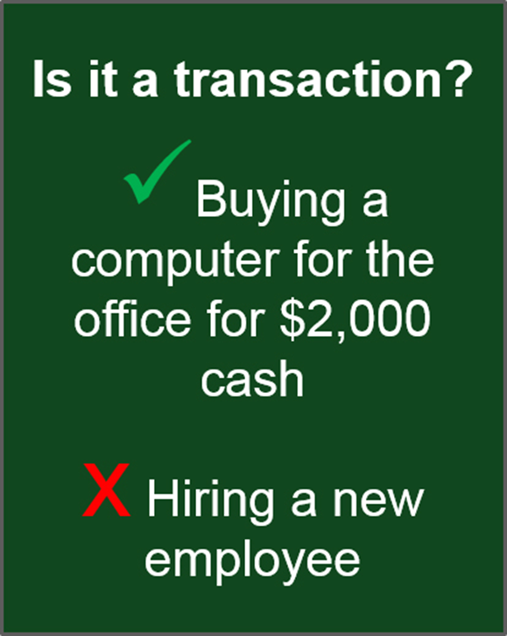
How Do You Analyze a Transaction?
A transaction is any event that affects the financial position of the business and can be measured with faithful representation.
Notes:
Transactions represent the activities of a business that affect the company’s financial position. Only events that can be measured in dollars are recorded as transactions. Therefore, meeting a potential customer and hiring an employee are business events, but they are not transactions from an accounting perspective.

Slide 34
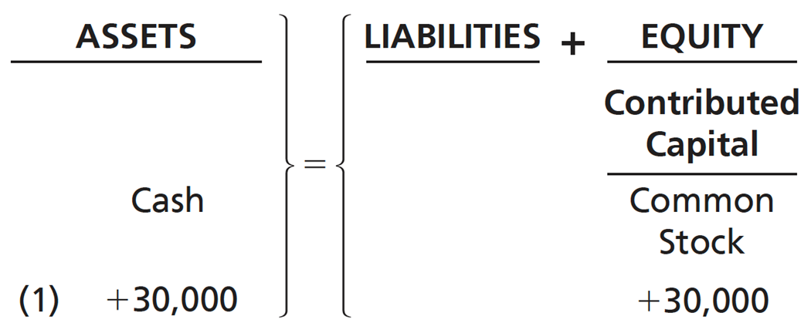
Transaction Analysis for Smart Touch Learning (1 of 9)
Transaction 1—Stockholder Contribution
Sheena Bright contributes $30,000 cash to Smart Touch Learning, a corporation, in exchange for stock. The effect of this transaction on the accounting equation is:
Notes:
Using the accounting equation, Smart Touch Learning records accounting transactions.
In the first example, Smart Touch Learning is a new business to which Sheena Bright contributes $30,000 cash in exchange for common stock. In this example, Cash and Common Stock both increase. An increase in Cash on the left side of the accounting equation and an increase in Equity on the right side of the accounting equation keep the accounting equation in balance.

Slide 35
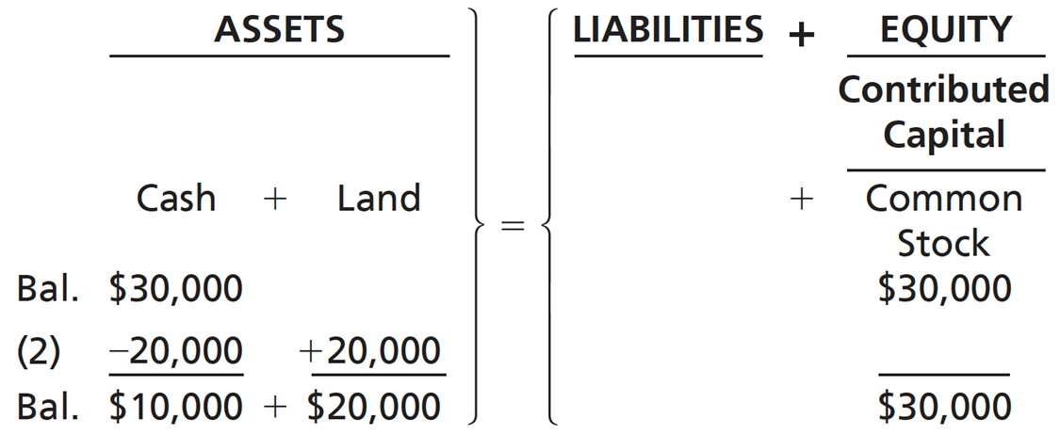
Transaction Analysis for Smart Touch Learning (2 of 9)
Transaction 2—Purchase of Land for Cash
Smart Touch Learning purchases land for an office location, paying cash of $20,000.
Notes:
In Transaction 2, Smart Touch Learning purchases land for $20,000 cash. In this case, Cash is decreased by $20,000. At the same time, Land is increased by $20,000. Essentially, we effectively turn one kind of economic resource (Cash) into a different kind of economic resource (Land). All the changes necessary to keep the accounting equation in balance occur on the left side of the equation.
Assets = liabilities + equity. The assets consist of $30,000 cash. The assets equal liabilities plus equity, which consists of contributed capital in the form of $30,000 of common stock. Transaction 2, $20,000 is subtracted from the cash assets and $20,000 is added to the land assets, leading to the following ending balances, Assets = $10,000 cash plus $20,000 land, Liabilities = $0, Equity = $30,000 common stock, contributed capital. $10,000 + $20,000 = $30,000.

Slide 36
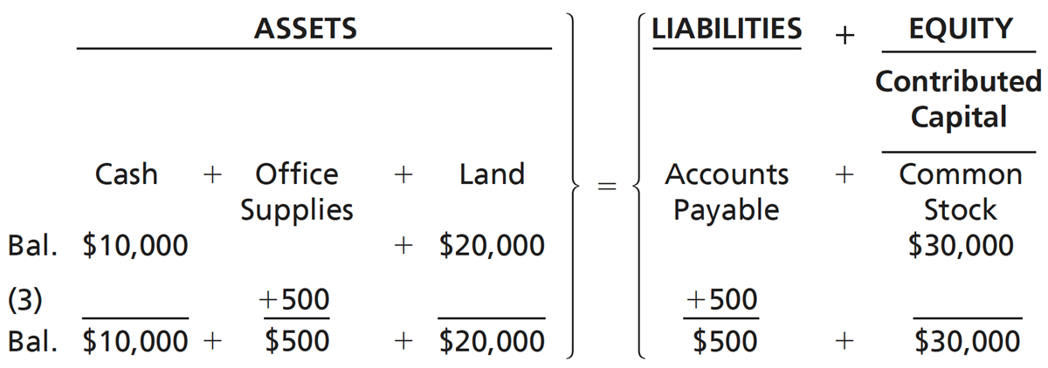
Transaction Analysis for Smart Touch Learning (3 of 9)
Transaction 3—Purchase of Office Supplies on Account
Smart Touch Learning buys office supplies on account agreeing to pay $500 within 30 days.
Notes:
In Transaction 3, Smart Touch Learning buys Office Supplies for $500. Rather than pay for the supplies at the time of purchase, the supplier has offered to let Smart Touch Learning pay later (usually in 30 days). In this case Office Supplies is an asset, not an expense, because the supplies have not yet been used. The liability created by purchasing “on account” is an Accounts Payable, which is a short-term liability that will be paid in the future. A payable is always a liability.
Assets = liabilities + equity. Starting balance: Assets = $10,000 cash + $20,000 land, Liabilities = $0; Equity (contributed capital) = $30,000 common stock. Transaction 3, $500 office supplies added to assets and $500 accounts payable added to liabilities. Ending balance: Assets = $10,000 cash + $500 office supplies + $20,000 land; Liabilities = $500 accounts payable, Equity = $30,000 common stock, contributed capital. $10,000 + $500 + $20,000 = $500 + $30,000.

Slide 37
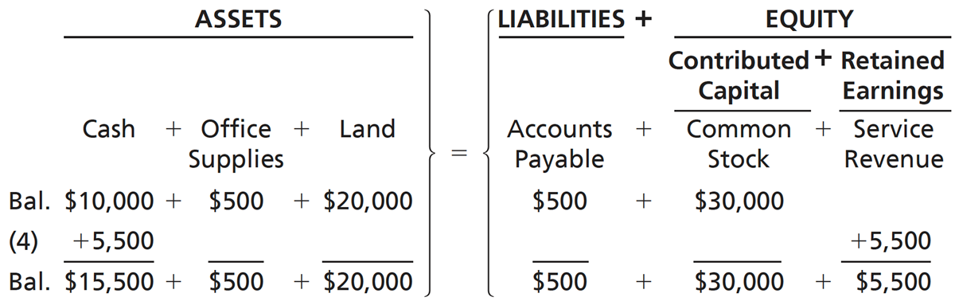
Transaction Analysis for Smart Touch Learning (4 of 9)
Transaction 4—Earning of Service Revenue for Cash
Smart Touch Learning earns service revenue by providing training services for clients. The business collects $5,500 revenue in cash.
Notes:
In Transaction 4, Smart Touch Learning provides training services to customers. The customers pay cash for the services. Cash increases because Smart Touch Learning collects cash upon completing the service. Revenue increases because services are provided to the customer.
Assets = liabilities + equity. Starting balance: Assets = $10,000 cash + $500 office supplies + $20,000 land. Liabilities = $500 accounts payable; Equity = $30,000 contributed capital, common stock. Transaction 3, $5,500 cash added to assets and $5,500 service revenue added to equity as retained earnings. Ending balance, Assets = $15,500 cash + $500 office supplies + $20,000 land, Liabilities = $500 accounts payable, Equity = $30,000 common stock, contributed capital + $5,500 service revenue, retained earnings. $15,500 + $500 + $20,000 = $500 + $30,000 + $5,500.

Slide 38
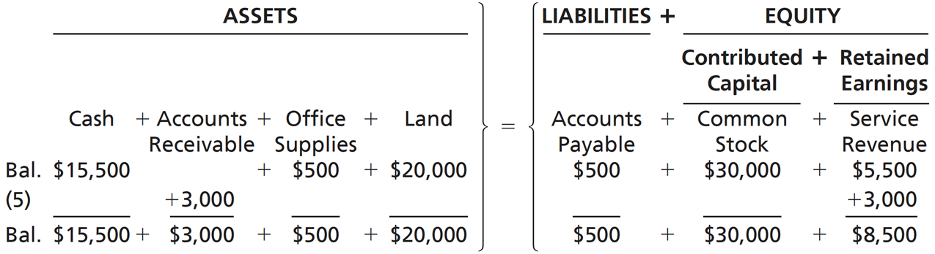
Transaction Analysis for Smart Touch Learning (5 of 9)
Transaction 5—Earning of Service Revenue on Account
Smart Touch Learning performs a service for clients who do not pay immediately. The clients promise to pay $3,000 within one month.
Notes:
In Transaction 5, Smart Touch Learning performs $3,000 of services for a customer but does not collect the cash. The customer is not expected to pay until the end of the month, so Accounts Receivable instead of Cash is recorded as an asset. Future payment from the customer is expected; therefore, Accounts Receivable is an asset. The revenue is earned because Smart Touch Learning has performed the service.
Note: The term “on account” can be used to represent Accounts Receivable if cash will be received in the future or Accounts Payable if cash will be paid in the future.
Assets = liabilities + equity. Starting balance: Assets = $15,500 cash + $500 office supplies + $20,000 land, Liabilities = $500 accounts payable; Equity = $30,000 common stock, contributed capital + $5,500 service revenue, retained earnings. Transaction 5: $3,000 accounts receivable added to assets and $3,000 service revenue, retained earnings added to equity. Ending balance, Assets = $15,500 cash + $3,000 accounts receivable + $500 office supplies + $20,000 land, Liabilities = $500 accounts payable, Equity = $30,000 common stock, contributed capital + $8,500 service revenue, retained earnings. $15,500 + $3,000 + $500 + $20,000 = $500 + $30,000 + $8,500.

Slide 39
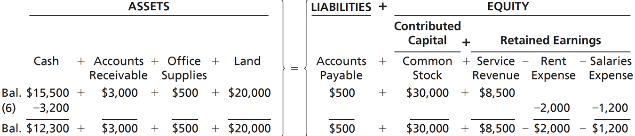
Transaction Analysis for Smart Touch Learning (6 of 9)
Transaction 6—Payment of Expenses with Cash
Smart Touch Learning pays $3,200 in cash expenses: $2,000 for office rent and $1,200 for employee salaries.
Notes:
In Transaction 6, Smart Touch Learning pays $3,200 for two expenses: $2,000 for office rent and $1,200 for employee salaries. Each expense is recorded separately and decreases equity. Cash is also decreased.
Assets = liabilities + equity. Starting balance: Assets = $15,500 cash + $3,000 accounts receivable + $500 office supplies + $20,000 land, Liabilities = $500 accounts payable, Equity = $30,000 common stock, contributed capital + $5,500 service revenue, retained earnings. Transaction 6, $3,200 cash subtracted from assets and $2,000 rent expense and $1,200 salaries expense subtracted from retained earnings in equity. Ending balance, Assets = $12,300 cash + $3,000 accounts receivable + $500 office supplies + $20,000 land. Liabilities = $500 accounts payable, Equity = $30,000 common stock, contributed capital + $8,500 service revenue, retained earnings minus $2,000 rent expense, retained earnings minus $1,200 salaries expense, retained earnings. $12,300 + $3,000 + $500 + $20,000 = $500 + $30,000 + $8,500 minus $2,000 minus $1,200.

Slide 40
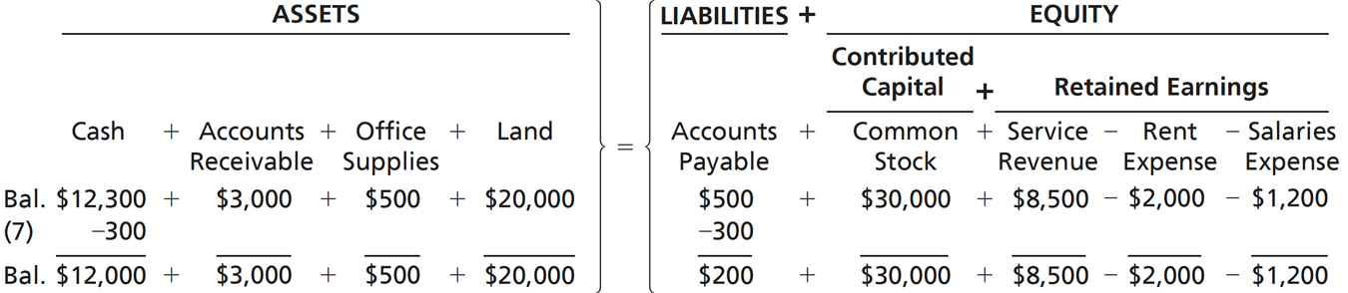
Transaction Analysis for Smart Touch Learning (7 of 9)
Transaction 7—Payment on Account (Accounts Payable)
Smart Touch Learning pays $300 to the store from which it purchased office supplies in Transaction 3.
Notes:
In Transaction 7, Smart Touch Learning pays for part of the office supplies that it purchased on account in Transaction 3. This decreases Smart Touch Learning’s cash by $300 while reducing the amount that Smart Touch Learning owes to the supplier.
Assets = liabilities + equity. Starting balance, Assets = $12,300 cash + $3,000 accounts receivable + $500 office supplies $20,000 land. Liabilities = $500 accounts payable. Equity = $30,000 common stock, contributed capital + $8,500 service revenue, retained earnings minus $2,000 rent expense, retained earnings minus $1,200 salaries expense, retained earnings. Transaction 7, $300 cash subtracted from assets and $300 accounts payable subtracted from liabilities. Ending balance, Assets = $12,000 cash + $3,000 accounts receivable + $500 office supplies + $20,000 land, Liabilities = $200 accounts payable; Equity = $30,000 common stock, contributed capital + $8,500 service revenue, retained earnings minus $2,000 rent expense, retained earnings minus $1,200 salaries expense, retained earnings. $12,000 + $3,000 + $500 + $20,000 = $200 + $30,000 + $8,500 minus $2,000 minus $1,200.

Slide 41
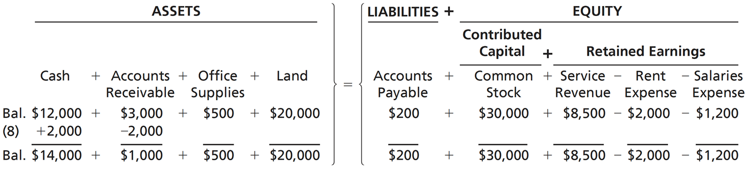
Transaction Analysis for Smart Touch Learning (8 of 9)
Transaction 8—Collection on Account (Accounts Receivable)
Smart Touch Learning now collects $2,000 from the client from Transaction 5.
Notes:
In Transaction 8, Smart Touch Learning collects $2,000 from the client to whom services were provided in Transaction 5. Note that while cash increases, the amount owed to Smart Touch Learning from the customer declines by an equal amount.
Assets = liabilities + equity. Starting balance, Assets = $12,000 cash + $3,000 accounts receivable + $500 office supplies + $20,000 land, Liabilities = $200 accounts payable, Equity = $30,000 common stock + $8,500 service revenue - $2,000 rent expense minus $1,200 salaries expense. Transaction 8, added $2,000 cash to assets and subtracted $2,000 accounts receivable from assets. Ending balance: Assets = $14,000 cash + $1,000 accounts receivable + $500 office supplies + $20,000 land, Liabilities = $200 accounts payable, Equity = $30,000 common stock + $8,500 service revenue minus $2,000 rent expense minus $1,200. $14,000 + $1,000 + $500 + $20,000 = $200 + $30,000 + $8,500 - $2,000 minus $1,200.

Slide 42
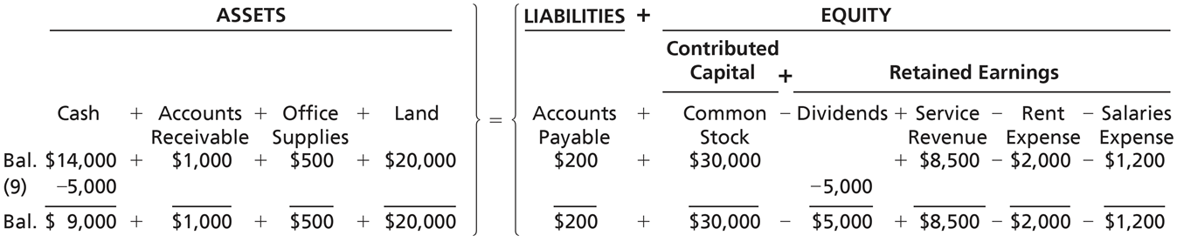
Transaction Analysis for Smart Touch Learning (9 of 9)
Transaction 9—Payment of Cash Dividend
Smart Touch Learning distributes a $5,000 cash dividend to the stockholder, Sheena Bright.
Notes:
In Transaction 9, Smart Touch Learning distributes a dividend to Sheena Bright, thereby decreasing Cash and Equity.
Assets = liabilities + equity. Starting balance: Assets = $14,000 cash + $1,000 accounts receivable + $500 office supplies + $20,000 land, Liabilities = $200 accounts payable, Equity = $30,000 common stock + $8,500 service revenue - $2,000 rent expense minus $1,200 salaries expense. Transaction 9. $5,000 cash subtracted from assets and $5,000 dividends, retained earnings subtracted equity. Ending balance, Assets = $9,000 cash + $1,000 accounts receivable + $500 office supplies + $20,000 land, Liabilities = $200 accounts payable, Equity = $30,000 common stock - $5,000 dividends + $8,500 service revenue minus $2,000 rent expense minus $1,200. $9,000 + $1,000 + $500 + $20,000 = $200 + $30,000 - $5,000 + $8,500 - $2,000 - $1,200.

Slide 43
Exhibit F:1-6 Analysis of Transactions, Smart Touch Learning (1 of 2)
Received $30,000 cash and issued common stock to Sheena Bright, stockholder.
Paid $20,000 cash for land.
Bought $500 of office supplies on account.
Received $5,500 cash from clients for service revenue earned.
Performed services for clients on account, $3,000.
Paid cash expenses: office rent, $2,000; employee salaries, $1,200.
Paid $300 on the accounts payable created in Transaction 3.
Collected $2,000 on the accounts receivable created in Transaction 5.
Paid cash dividends of $5,000 to stockholder, Sheena Bright.
Notes:
Exhibit F:1-6 shows the nine accounting transactions and provides a summary for the ending account balances.

Slide 44
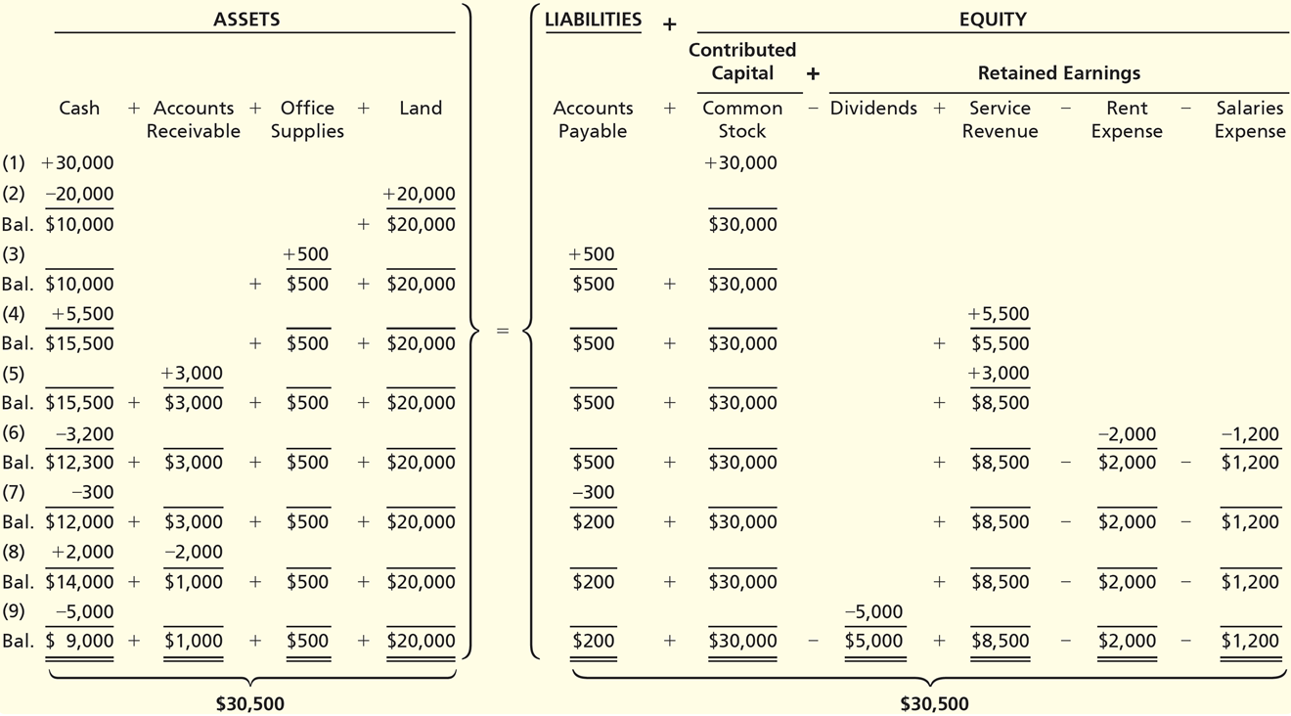
Exhibit F:1-6 Analysis of Transactions, Smart Touch Learning (2 of 2)
Notes:
Notice the Assets equals $30,500, and the Liabilities plus Equity also equals $30,500.
Each transaction and balance described in the following table occupies a new row of the analysis, with the amount above the balance single-underlined to indicate a calculation. In any given row, the sum of the amounts in the Assets columns equals the sum of the amounts in the Liabilities and Equity columns. The following accounting equations define assets, liabilities, and equity for the value shown in the table. Assets = liabilities + equity. Assets = cash + accounts receivable + office supplies + land. Liabilities = accounts payable. Equity = contributed capital + retained earnings. Contributed capital = common stock.
Retained earnings = minus dividends + service revenue minus rent expense minus salaries expense. A Table has 17 Row s and 11 columns. The columns have the following headings from left to right. Transaction or balance, Cash, Accounts Receivable, Office Supplies, Land, Accounts Payable, Common stock, Dividends, Service revenue, Rent expense, Salaries expense, . The Row entries are as follows. Line 1. 1, 30000, blank, blank, blank, Blank, 30000, blank, blank, blank, blank. Line 2. 2, negative 20,000, blank, blank, 20000, blank, blank, blank, blank, blank, blank. Line 3. Balance, 10000, blank, blank, 20000, blank, 30000, blank, blank, blank, blank. Line 4. 3, blank, blank, 500, blank, 500, blank, blank, blank, blank, blank. Line 5. Balance, 10000, blank, 500, 20000, 500, 30000, blank, blank, blank, blank. Line 6. 4, 5500, blank, blank, blank, blank, blank, blank, 5500, blank, blank. Line 7. Balance, 15500, blank, 500, 20000, 500, 30000, blank, 5500, blank, blank. Line 8. 5, blank, 3000, blank, blank, blank, blank, blank, 3000, blank, blank. Line 9. Balance, 15500, 3000, 500, 20000, 500, 30000, blank, 8500, blank, blank. Line 10. 6, negative 3,200, blank, blank, blank, blank, blank, blank, blank, negative 2,000, negative 1,200. Line 11. Balance, 12300, 3000, 500, 20000, 500, 30000, blank, 8500, 2000, 1200. Line 12. 7, negative 300, blank, blank, blank, negative 300, blank, blank, blank, blank, blank. Line 13. Balance, 12000, 3000, 500, 20000, 200, 30000, blank, 8500, 2000, 1200. Line 14. 8, 2000, negative 2,000, blank, blank, blank, blank, blank, blank, blank, blank. Line 15. Balance, 14000, 1000, 500, 20000, 200, 30000, blank, 8500, 2000, 1200. Line 16. 9, negative 5,000, blank, blank, blank, blank, blank, negative 5,000, blank, blank, blank. Line 17. Balance, 9000, 1000, 500, 20000, 200, 30000, 5000, 8500, 2000, 1200.

Slide 45
Learning Objective 1.5
Prepare financial statements

Slide 46
How Do You Prepare Financial Statements? (1 of 2)
Exhibit F:1-7 Financial Statements
Financial Statement | Information Provided and Purpose | How Is It Prepared?
Income statement | Provides information about profitability for a particular period for the company | Revenues minus Expenses = Net Income or Net Loss
Statement of retained earnings | Informs users about how much of the earnings were kept and reinvested in the company | Retained Earnings, Beginning plus Net income or minus Net loss for the period minus Dividends for the period = Retained Earnings, Ending
Balance sheet | Provides valuable information to financial statement users about economic resources the company has (assets) as well as debts the company owes (liabilities) and allows decision makers to determine their opinion about the financial position of the company | Assets = Liabilities + Stockholders’ Equity
Statement of cash flows | Reports on a business’s cash receipts and cash payments for a period of time | Cash flows from operating activities Cash flows from investing activities Cash flows from financing activities
Notes:
Using the data summarized in Exhibit F:1-6, the four main financial statements are prepared. The first financial statement prepared is the income statement, followed by the statement of retained earnings. The balance sheet is the third statement prepared, and the statement of cash flows is the final report prepared.

Slide 47
How Do You Prepare Financial Statements? (2 of 2)
Financial statements are business documents that are used to communicate information needed to make business decisions.
The Income Statement reports the net income or net loss of the business for a specific period.
The Statement of Retained Earnings reports how the company’s retained earnings balance changed from the beginning to the end of the period.
The Balance Sheet reports on the assets, liabilities, and stockholders’ equity of the business as of a specific date.
The Statement of Cash Flows reports on a business’s cash receipts and cash payments for a specific period.
Notes:
The income statement provides information about profitability for a particular period for a business.
The statement of retained earnings informs users how much of the earnings were retained and reinvested in the company.
The balance sheet reports the business entity’s economic resources (assets), the amount of debt owed to creditors (liabilities), and the net worth of the entity (equity). The balance sheet shows the financial position of the company. The statement of cash flows shows how cans changed over the period.

Slide 48
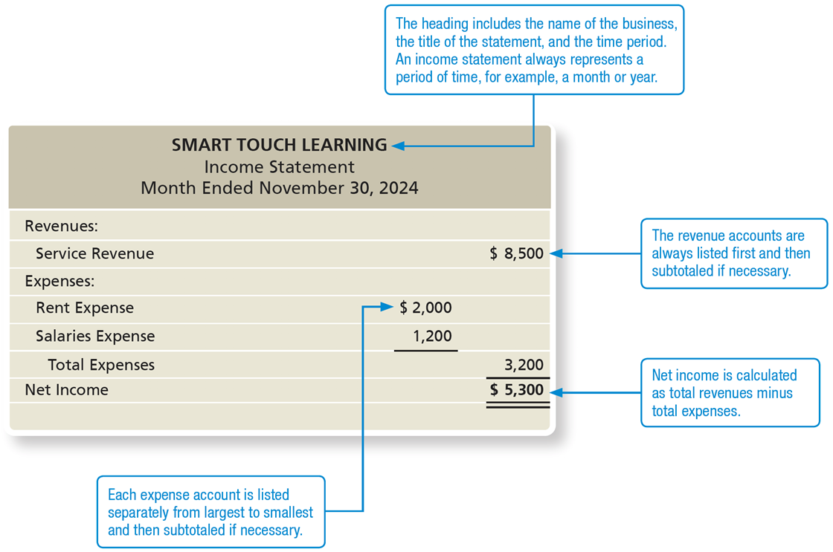
Exhibit F:1-8 Income Statement
Notes:
The income statement represents a summary of a business entity’s revenues and expenses for a period of time. The income statement tells whether the business generated net income or suffered a net loss. Only revenues and expenses are reported on the income statement.
At the top of the following statement, the header includes the name of the business, the title of the statement, and the time period. An income statement always represents a period of time, for example, a month or year. In the right column, the revenue accounts are always listed first and then subtotaled if necessary. In the middle column, each expense is listed separately from largest to smallest and then subtotaled if necessary. At the bottom of the right column, the net income is calculated as total revenues minus total expenses. As with all financial statements in this chapter, the following statement contains dollar amounts, with amounts in parentheses begin subtracted. A single underline in a cell indicates a calculation using the amounts in and above the cell. A double underline indicates the amount in the cell is a total. An income statement for Smart Touch Learning for the month ended November 30, 20 24. A Table has 7 Row s and 3 columns. The columns have the following headings from left to right. Account, Account amount , Account totals, . The Row entries are as follows. Line 1. Revenues., blank, blank. Line 2. Service Revenue, blank, $8,500. Line 3. Expenses., blank, blank. Line 4. Rent Expense, $2,000, blank. Line 5. Salaries Expense, 1200, blank. Line 6. Total Expenses, blank, 3200. Line 7. Net Income, blank, $5,300 .

Slide 49
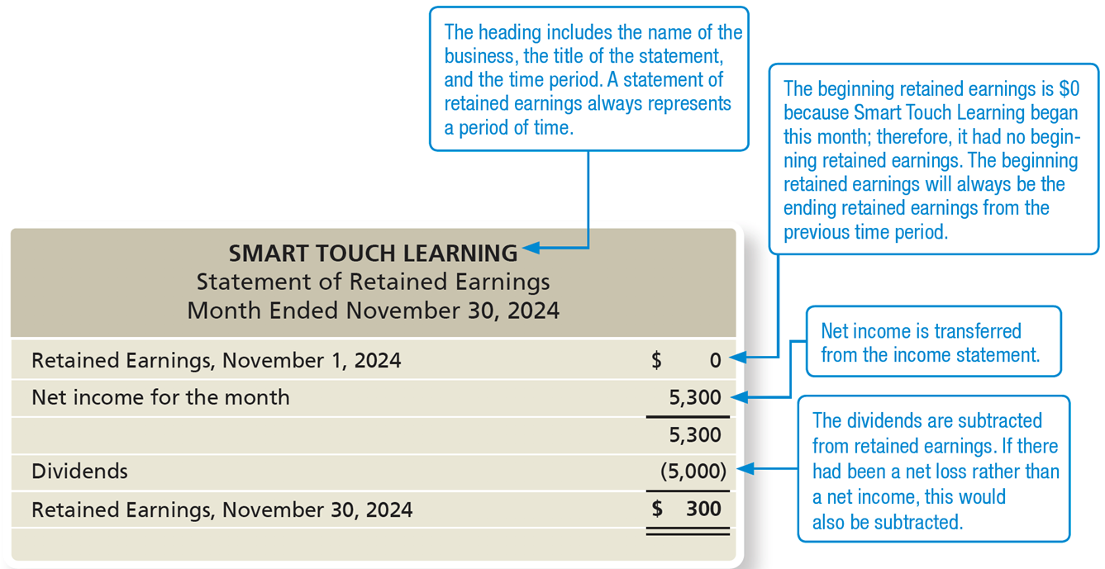
Exhibit F:1-9 Statement of Retained Earnings
Notes:
The statement of retained earnings shows the changes in retained earnings for a business entity during a time period. The net income or loss from the income statement is transferred from the income statement.
At the top of the following statement, the header includes the name of the business, the title of the statement, and the time period. A statement of retained earnings always represents a period of time.
In the first line, the beginning retained earnings is $0 because Smart Touch Learning began this month; therefore, it had no beginning retained earnings. The beginning retained earnings will always be the ending retained earnings from the previous time period. In the second line, net income is transferred from the income statement. The dividends are subtracted from retained earnings. If there had been a net loss rather than a net income, this would also be subtracted. A statement of retained earnings for Smart Touch Learning for the month ended November, 30, 20 24. A Table has 5 Row s and 2 columns. The columns have the following headings from left to right. Account, Dollar amount. The Row entries are as follows. Line 1. Retained Earnings, November 1, 20 24, $0. Line 2. Net income for the month, 5300. Line 3. Blank, 5300. Line 4. Dividends, Negative 5,000, shown within parenthesis. Line 5. Retained Earnings, November 30, 20 24, $300 .

Slide 50
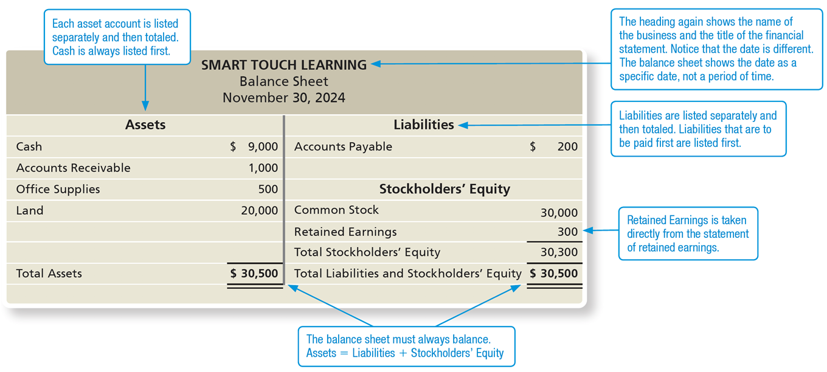
Exhibit F:1-10 Balance Sheet
Notes:
The balance sheet lists a business entity’s assets, liabilities, and stockholders’ equity as of a specific date. The balance sheet is a snapshot of the entity.
Notice that the data is different. The balance sheet shows the date as a specific date, not a period of time. On the left half of the sheet, each asset account is listed separately and then totaled. Cash is always listed first. At the top of the sheet’s right half, liabilities are listed separately and then totaled. Liabilities that are to be paid are listed first. Retained Earnings is taken directly from the statement of retained earnings. As shown by the amounts in Total Assets and Total Liabilities and Stockholders’ Equity, the balance sheet must always balance. Assets = liabilities + equity. A balance sheet for Smart Touch Learning, November 30, 20 24. A Table has 6 Row s and 2 columns. The columns have the following headings from left to right. Assets, Dollar amount. The Row entries are as follows. Line 1. Cash, $9,000. Line 2. Accounts Receivable, 1000. Line 3. Office Supplies, 500. Line 4. Land, 20000. Line 5. Blank, Blank. Line 6. Total Assets, $30,500 . For Liability, A Table has 1 Row s and 2 columns. The columns have the following headings from left to right. Liabilities, Dollar amount. The Row entries are as follows. Line 1. Accounts Payable, $200. For Stockholders’ Equity. A Table has 4 Row s and 2 columns. The columns have the following headings from left to right. Account, Dollar Amount. The Row entries are as follows. Line 1. Common Stock, 30000. Line 2. Retained Earnings, 300. Line 3. Total Stockholders’ Equity, 30300. Line 4. Total Liabilities and Stockholders’ Equity, $30,500 .

Slide 51
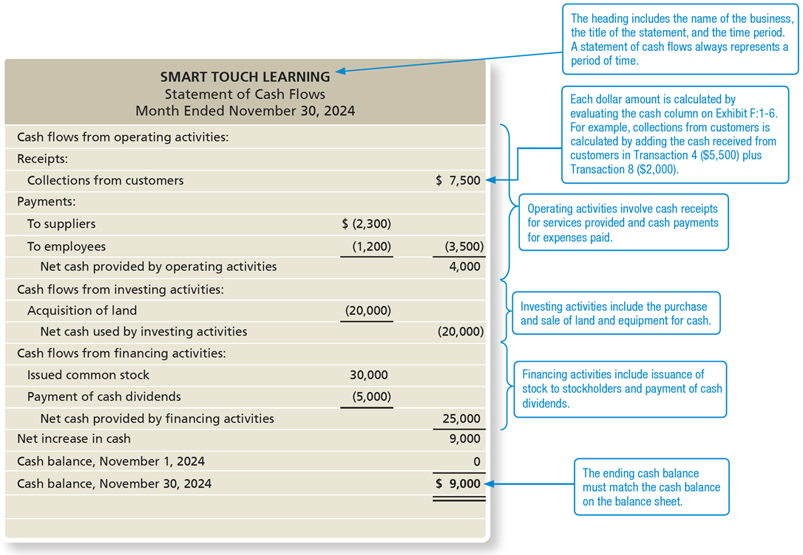
Exhibit F:1-11 Statement of Cash Flows
Notes:
The statement of cash flows reports the change in cash during the period. The ending cash balance on the statement of cash flows is the same as the ending cash reported on the balance sheet. The statement of cash flows is divided into three sections: operating, investing, and financing.
At the top of the following statement, the heading includes the name of the business, the title of the statement, and the time period. A statement of cash flows always represents a period of time.
Each dollar amount is calculated by evaluating the cash column on Exhibit 1-6. For example, collections from customers is calculated by adding the cash received from customers in Transaction 4 ($5,500) plus Transaction 8, $2,000. As listed in rows 1 to 7, the operating activities involve cash receipts for services provided and payment of cash payments for expenses paid. As listed in rows 8 to 10, investing activities include the purchase and sale of land and equipment for cash. As listed in rows 11 to 14, financing activities include issuance of stock to stockholders and payment of cash dividends. In the bottom row, the ending cash balance must match the cash balance on the balance sheet. A statement of cash flows for Smart Touch Learning for the month ended November 30, 20 24. A Table has 17 Row s and 3 columns. The columns have the following headings from left to right. Account, Debit, Credit, . The Row entries are as follows. Line 1. Cash from operating activities:, Blank, blank. Line 2. Receipts:, Blank, blank. Line 3. Collections from customers, Blank, $7,500. Line 4. Payments, Blank, blank. Line 5. To suppliers, Negative 2,300, shown within parenthesis, blank. Line 6. To employees, Negative 1,200, shown within parenthesis, Negative 3,500, shown within parenthesis. Line 7. Net cash provided by operating activities, blank, 4000. Line 8. Cash flows from investing activities:, Blank, blank. Line 9. Acquisition of land, Negative 20,000, shown within parenthesis, blank. Line 10. Net cash used by investing activities, Blank, Negative 20,000, shown within parenthesis. Line 11. Cash flows from financing activities:, Blank, blank. Line 12. Issued common stock, 30000, blank. Line 13. Payment of cash dividends, Negative 5,000, shown within parenthesis, blank. Line 14. Net cash provided by financing activities, Blank, 25000. Line 15. Net increase in cash, Blank, 9000. Line 16. Cash balance, November 1, 20 24, Blank, 0. Line 17. Cash balance, November 30, 20 24, Blank, 9000.

Slide 52
Learning Objective 1.6
Use financial statements and return on assets (R O A) to evaluate business performance

Slide 53
How Do You Use Financial Statements to Evaluate Business Performance? (1 of 2)
One of the many tools used to evaluate performance is return on assets.
Return on assets (R O A) measures how profitably a company uses it assets.
R O A is calculated by dividing net income by average total assets.
Notes:
Return on assets is a tool users of financial statements use to determine how well a company is performing. Return on assets measures how well a company uses its assets to generate net income. The formula to calculate return on assets is Net income / Average total assets.

Slide 54
How Do You Use Financial Statements to Evaluate Business Performance? (2 of 2)
On its 2018 income statement, Kohl’s reported net income of $801 million. The corporation reported beginning total assets (found on the balance sheet) of $13,389million and ending total assets of $12,469 million. Kohl’s return on assets for 2018 is (all amounts in millions):
Notes:
For investors to evaluate whether Kohl’s 6.2% ROA is good or bad, they should compare it to the ROAs of competing companies, such as Target Corporation and J.C. Penney Corporation, Inc. If Target Corporation’s ROA was 7.2% and J.C. Penney Corporation’s ROA was (3.2%), then Kohl’s and Target have stronger ROAs than J.C. Penney Corporation. This means that Kohl’s and Target produce more profit per every dollar of assets than J.C. Penney does. In fact, J.C. Penney did not earn a profit in 2018, but instead had a net loss as indicated by its negative ROA.

Slide 55

Copyright
This work is protected by United States copyright laws and is provided solely for the use of instructors in teaching their courses and assessing student learning. Dissemination or sale of any part of this work (including on the World Wide Web) will destroy the integrity of the work and is not permitted. The work and materials from it should never be made available to students except by instructors using the accompanying text in their classes. All recipients of this work are expected to abide by these restrictions and to honor the intended pedagogical purposes and the needs of other instructors who rely on these materials.

